Slide 1
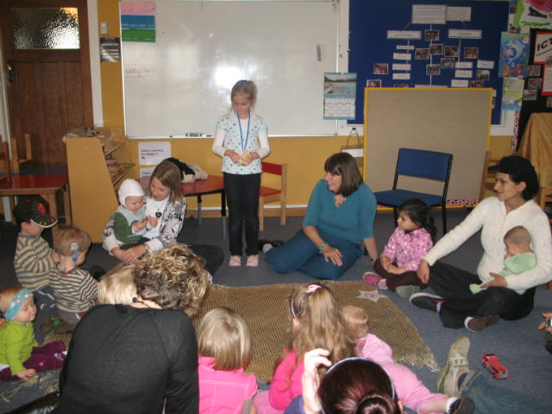
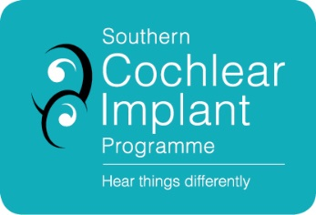
Why Auditory-Verbal Therapy?
Enabling your deaf child to listen and speak like you!
Alexandra Crosbie LSLS Cert AVT
Jill Mustard LSLS Cert AVT
Joint presentation for Hui, by NCIP/SCIP
2015

Slide 2
Areas to be covered
What is Auditory Verbal Therapy?
Why AVT?
AV Techniques.
Elements of AVT.
Turning everyday into language learning.
The Hearing House.
SCIP.
Video Footage.
Questions.

Slide 3
What is Auditory Verbal Therapy?
Speech and language developed through listening.
Parental guidance.
Creating a listening environment all the time.
Following the typical stages of listening, language and speech.
Requires:
Early identification/diagnosis.
Maximised auditory potential.
Parents committed to providing 1:1 time for their child every day.
Audition as primary focus.
Whole child approach.

Slide 4
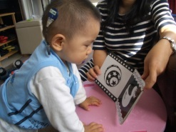
Why AVT?
90% of deaf children are born to listening speaking parents^{1, 2, 3, 4}.
With current technology (hearing aids and cochlear implants) most deaf children are able to hear all the sounds of speech.
With early amplification more than 90% can speak at the same level as their hearing peers by the time they are five⁵.

Slide 5
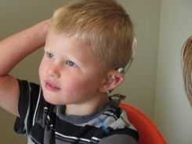
Why AVT?
Auditory Verbal Therapy supports and coaches parents to help their children learn spoken language through listening.
How much parents talk to their child is the best predictor of their child’s language competence⁶.
Children with normal hearing who speak well have heard 45 million words by age 4⁷.

Slide 6
Why AVT?
We monitor our own speech through listening.
We get more speech information through listening than lip-reading e.g. pat – bat – mat.
90% of what children know they learn incidentally – learn casually and passively through overhearing ⁶.

Slide 7
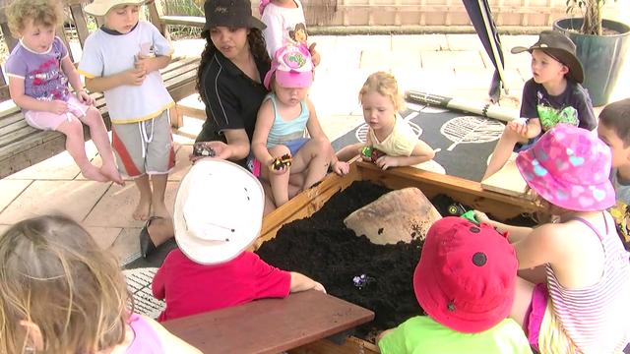
Why AVT?
School readiness - Children spend most of their day at school learning through listening.
Children can use the language of their friends.
Learning to listen well helps children listen when visual cues aren’t available.

Slide 8
Why AVT?
Reading is also an auditory activity – e.g. rhyming words, recognising what sound a word starts with.
20,000 hours of listening needed to learn to read ⁸.

Slide 9
AV Techniques ….. How they are different?
Understanding that sound has meaning.
Appropriate positioning.
Being aware of auditory environment.
Use parentese.
Waiting.
Developing imitation in early stages.

Slide 10
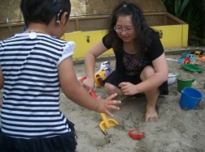
AV Techniques ….. How they are different?
Acoustic Highlighting.
Auditory Sandwich.
Extend vocabulary.
Expanding on child’s utterances.
Auditory feedback system.
Learning to listen, enabling listening for learning.

Slide 11
Elements of AVT
It’s child’s play .…plus…
Regular sessions.
Parents as partners.
Structured around age-appropriate play.
Individual Short Term Goals.
Individual Lesson Plans.
What’s in a Session.

Slide 12
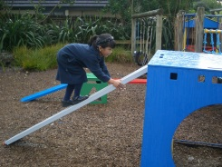
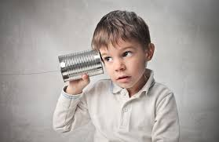
Turn everyday into language learning
Listening check
(Play video clip of Isla)

Slide 13
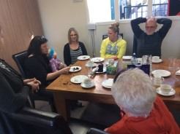
Turn everyday into language learning
Folding the Washing

Slide 14
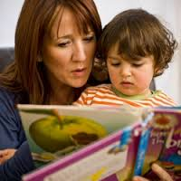
Turn everyday into language learning
Sharing Books

Slide 15
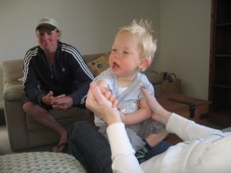
The Hearing House
Auditory-verbal therapy :
0 – 5 years - The Hearing House.
5-19 years - KDEC.
Audiology (0 – 19 years).
Family support (0-19 years).
Preschool (3 – 5 years).

Slide 16
The Hearing House
Provide specialist Auditory-Verbal Therapy that coaches parents to work with their children.
Children follow:
Auditory-verbal Therapy (AVT).
Auditory Language Enrichment (ALE).
Total number of children on programme = 237.
Children under 5 on programme = 50.
The Hearing House - 3 Habilitationists + Habilitation Manager.
KDEC - 2 Habilitationists.

Slide 17
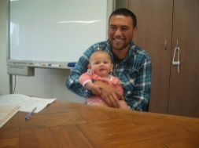
The Hearing House
Service children with mild to profound losses who have cochlear implants and/or hearing aids.
Supports families from the top of the North Island to National Park.
Variety of programme options: onsite, outreach and TeleChat, group sessions, workshops.
Ability to work with other professionals, e.g. AoDC, RTD, EI, SLT, CDT, Glowkids etc.
Consults and liaises with centres from overseas.

Slide 18
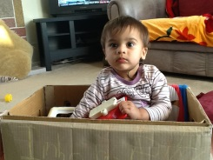
Southern Cochlear Implant Services
Provide a range of programmes:
- Auditory Verbal Therapy.
- Auditory Enhanced Programmes.
Use Auditory Verbal strategies e.g. auditory highlighting, repetition, coming closer, developing auditory feedback.
CI provides access to sound – develop hearing in the first instance.
Provide individual sessions for family and child at SCIP, at home or preschool or via SKYPE.

Slide 19
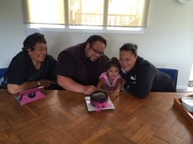
Southern Cochlear Implant Services
Support a wide geographic area.
Work with Resource Teachers of Deaf, Advisers, ESW, SLTs:
- develop programmes.
- coach use of Auditory Verbal strategies.
- demonstrate AVT with child.
- provide training workshops.

Slide 20
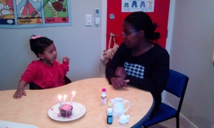
Southern Cochlear Implant Services
2 clinics.
180 children.
SCIP Christchurch - 2 Habilitationists. + Clinical Manager.
SCIP Wellington - 2 Habilitationists.
Children through to Adult services.

Slide 21
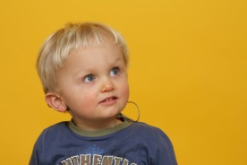
Video Clip…
Play video clip of Isla

Slide 22
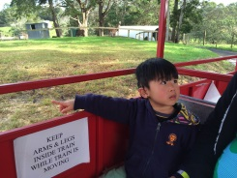
Questions?
Alexandra Crosbie
alexandra@hearinghouse.co.nz
Jill Mustard
Jill.mustard@scip.co.nz

Slide 23
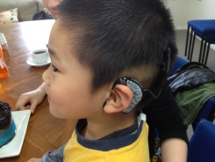
References and Notes
1. Mitchell Ross E, Karchmer Michael A. (2004) "Chasing the mythical ten percent: Parental hearing status of deaf and hard of hearing students in the United States". Sign Language Studies 4 Gallaudet University Press. (2): 138–163. doi:10.1353/sls.2004.0005.
2. Moores D. (1978) Educating the Deaf: Psychology, Principles, and Practices. Boston: Houghton Mifflin.
3. Salend S. (2001) Creating Inclusive Classrooms: Effective and Reflective Practices. 4th Ed. Columbus, OH: Merrill Prentice Hall.
4. These parents communicate via spoken language. As a result, they are able to provide their children with a rich spoken language environment, which is critical for learning.
5. Cole E, & Flexer C. (2007) Children with hearing loss: Developing listening and talking birth to six. San Diego, CA: Plural Publishing.
6. Flexer C. (2014) Auditory Brain Development: The Foundation of Listening, Language & Listening. Seminar 20-21 March 2014, Auckland NZ
7. Hart B, & Risley T.R. (1995) Meaningful differences in the everyday experiences of young American children. Baltimore: Brookes
8. Dehaene S. (2009) Reading In The Brain: The New Science of How We Read. New York: Penguin

